Slide 1
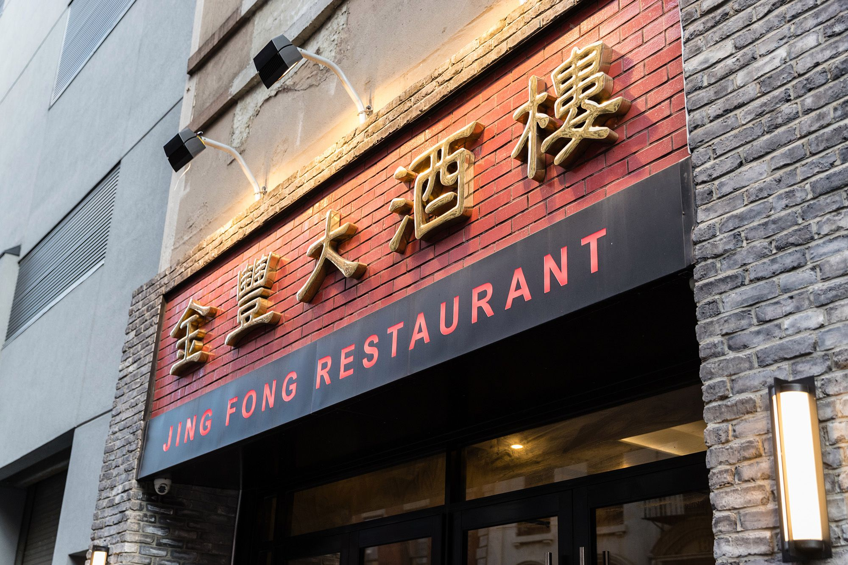

Slide 2
Predicting optimal location for establishing a Chinese restaurant

Slide 3
Identifying optimal locations for establishing Chinese restaurant is valuable for any business person
First of all, exploring optimal places for establishing restaurant business will be valuable for anyone who has interests in opening a Chinese restaurant or big franchise companies considering opening subsidiaries
Helps to find places where demand will be potentially high
Such optimal locations result in mostly profit maximization

Slide 4
Data acquisition and cleaning
Census data containing information about household income of Toronto’s population, Chinese population living in each neighborhood of Toronto was obtained from Toronto’s Open Data Portal (link: http://map.toronto.ca/wellbeing).
Neighborhoods with postal codes and boroughs were scraped from Wikipedia page (link: https://en.wikipedia.org/wiki/List_of_postal_codes_of_Canada:_M)
Geographical coordinates of each neighborhood were acquired using the following link: (https://cocl.us/Geospatial_data).
All Asian restaurants located in each neighborhood were identified using Foursquare API.
Only the cells that have an assigned borough will be processed; boroughs that were not assigned were ignored.
Neighborhoods missing more than two census data value were dropped.
A column that features the percentage of distribution of Chinese population across each neighborhood was calculated by dividing the population of the Chinese demographic by the total population of each neighborhood; the two latter columns were then made redundant and dropped.

Slide 5
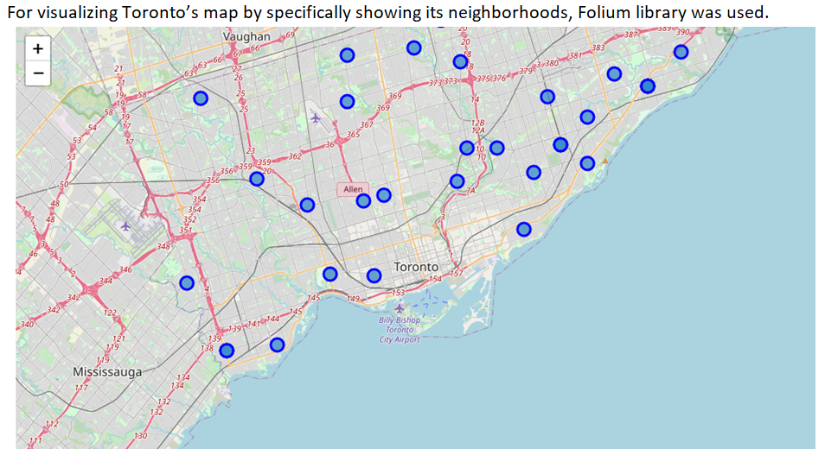
Exploratory Data analysis (Folium mapping)

Slide 6
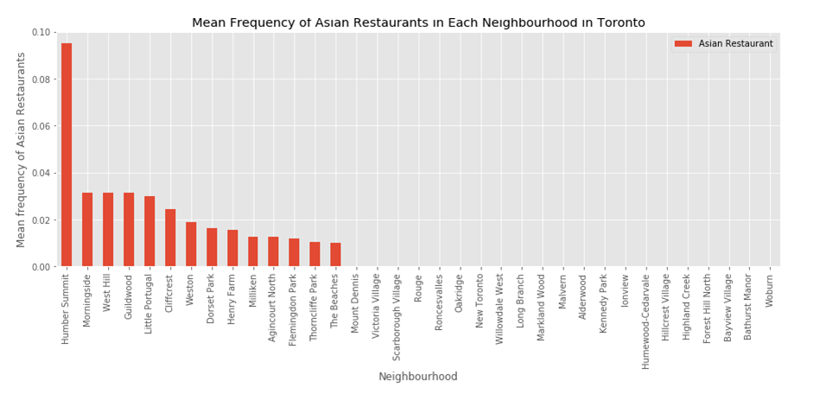
Frequency Distribution of Asian Restaurants

Slide 7
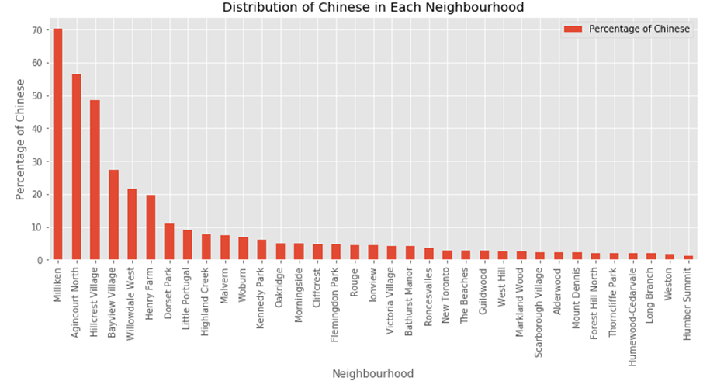
Distribution of the Chinese Demographic

Slide 8
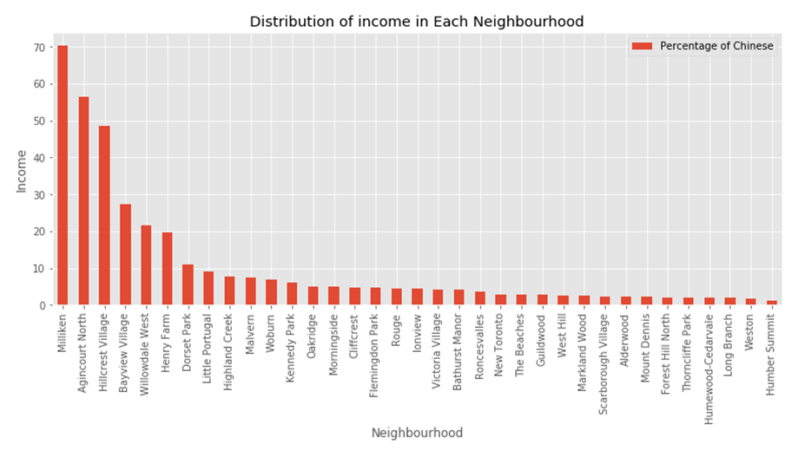
Distribution of Household Income

Slide 9
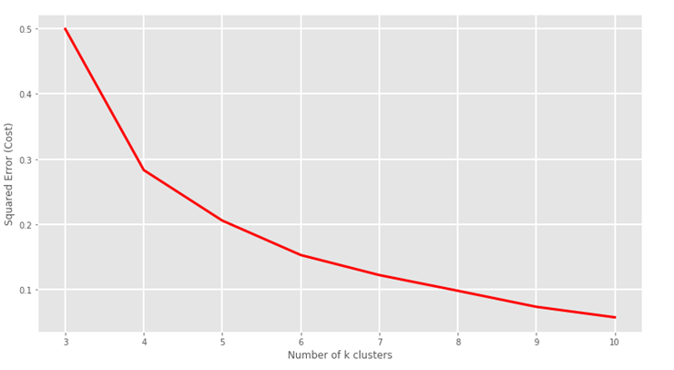
K-Means clustering

Slide 10
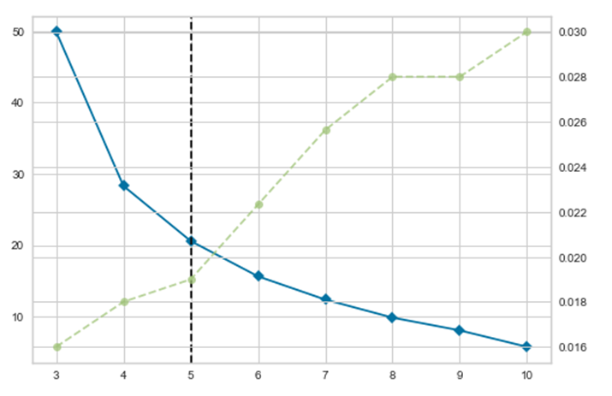
Using K Elbow Visualizer to identify K

Slide 11
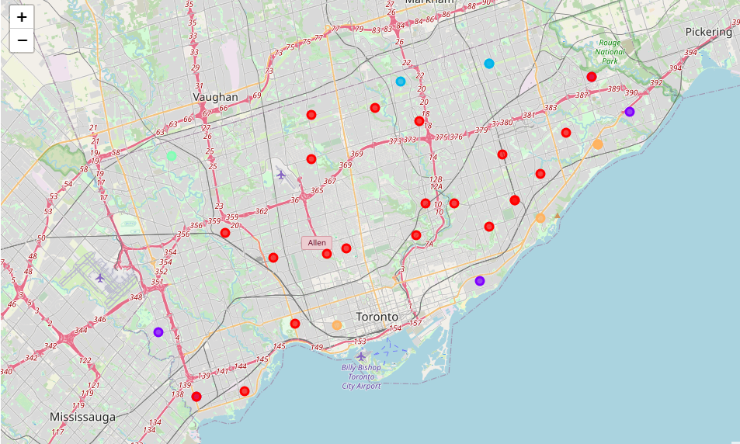
Labeled Folium map (red: Cluster 0, purple: c1, light blue: c2, light green: c3, orange: c4)

Slide 12
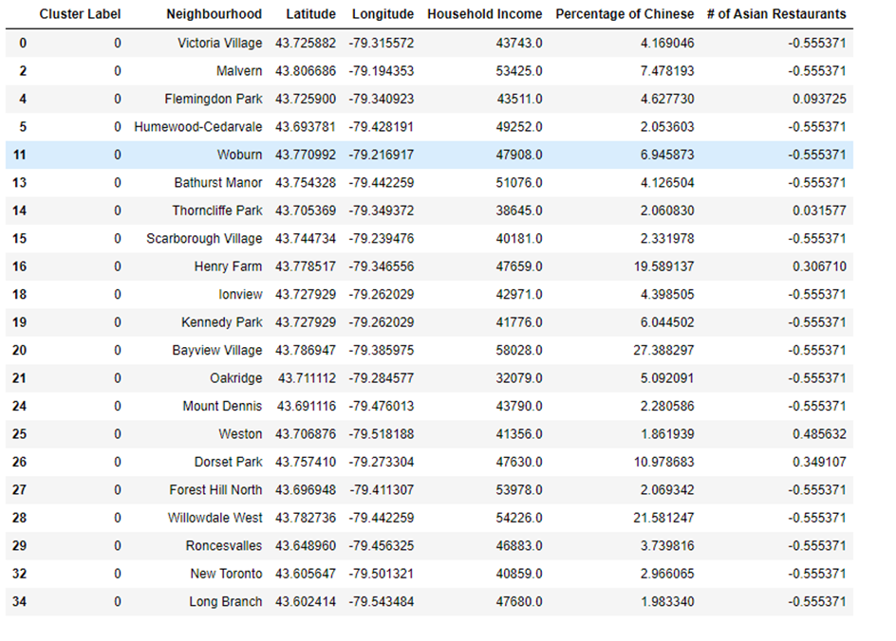
Cluster 0

Slide 13
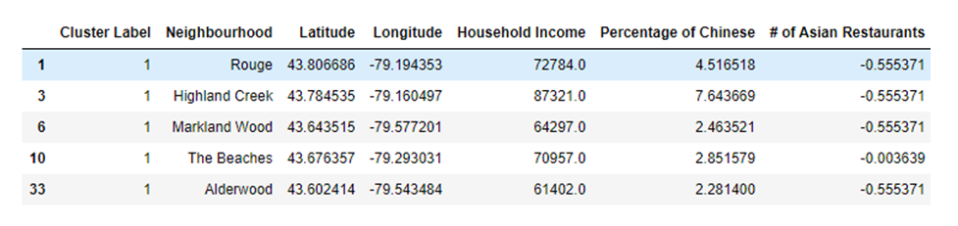
Cluster 1

Slide 14
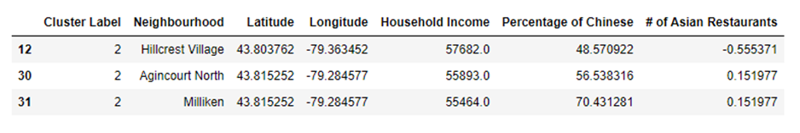
Cluster 2

Slide 15

Cluster 3

Slide 16
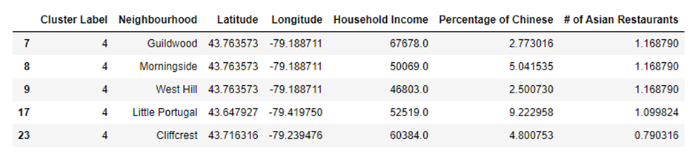
Cluster 4

Slide 17
Conclusion
In conclusion, after analyzing all the clusters, cluster 2 is the best area to build Chinese restaurant. All the areas in the cluster 0, potentially good places for building Chinese restaurant, because density of Chinese people living in the areas belonging to cluster 2 is high and density of Asian restaurants is low. Moreover, specifically, Hillcrest Village is the best one as there are a lot of Chinese people but no Chinese restaurants.

